Slide 1
Paper Flow
Partitioning our System

Slide 2
Create a Paper Flow
Our goal here is to create a paper flow for a process
  Then we can use that paper process to think about how we could partition our system
  Team Topologies calls these points “fracture planes”
  For an event driven architecture, fracture planes around “hand offs”, inbox to outbox help us build a robust system
  ”ACID” transactions take place at a desk; “BASE” takes place across desks

Slide 3
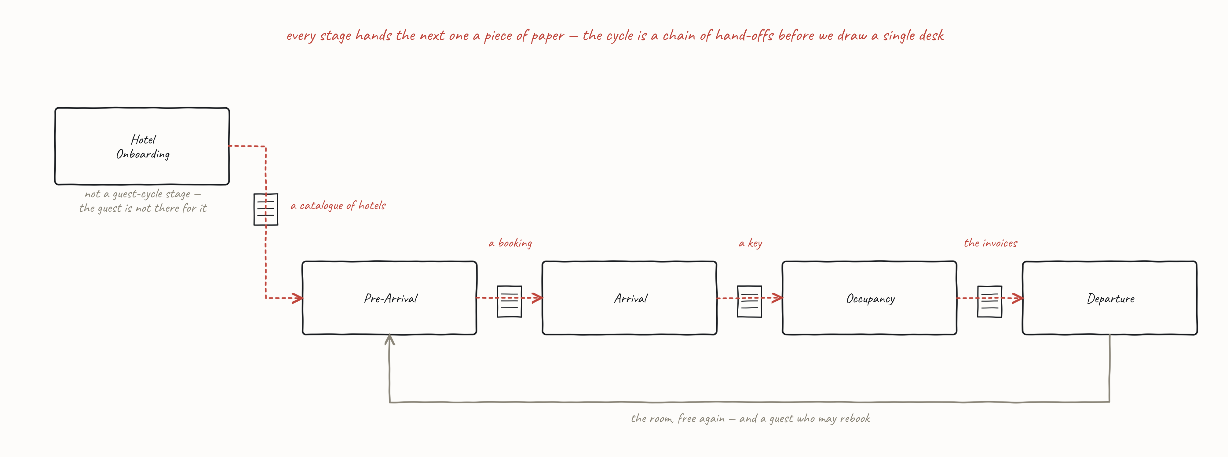
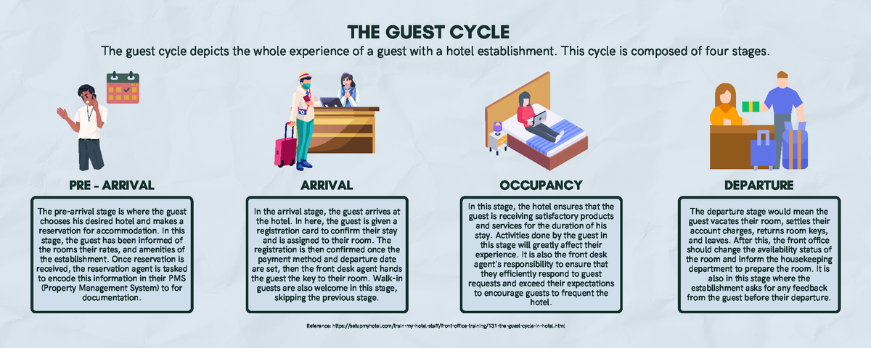
Notes:
The map of the domain, and the table allocation. Two things to say and then move on. Onboarding sits outside the loop because the guest is not there for it -- that matters, because five tables are about to take five stages and only four of them are guest-cycle stages. And every stage hands the next one a piece of paper: catalogue, booking, key, invoices. The cycle is a chain of hand-offs before anyone has drawn a desk.

Slide 4
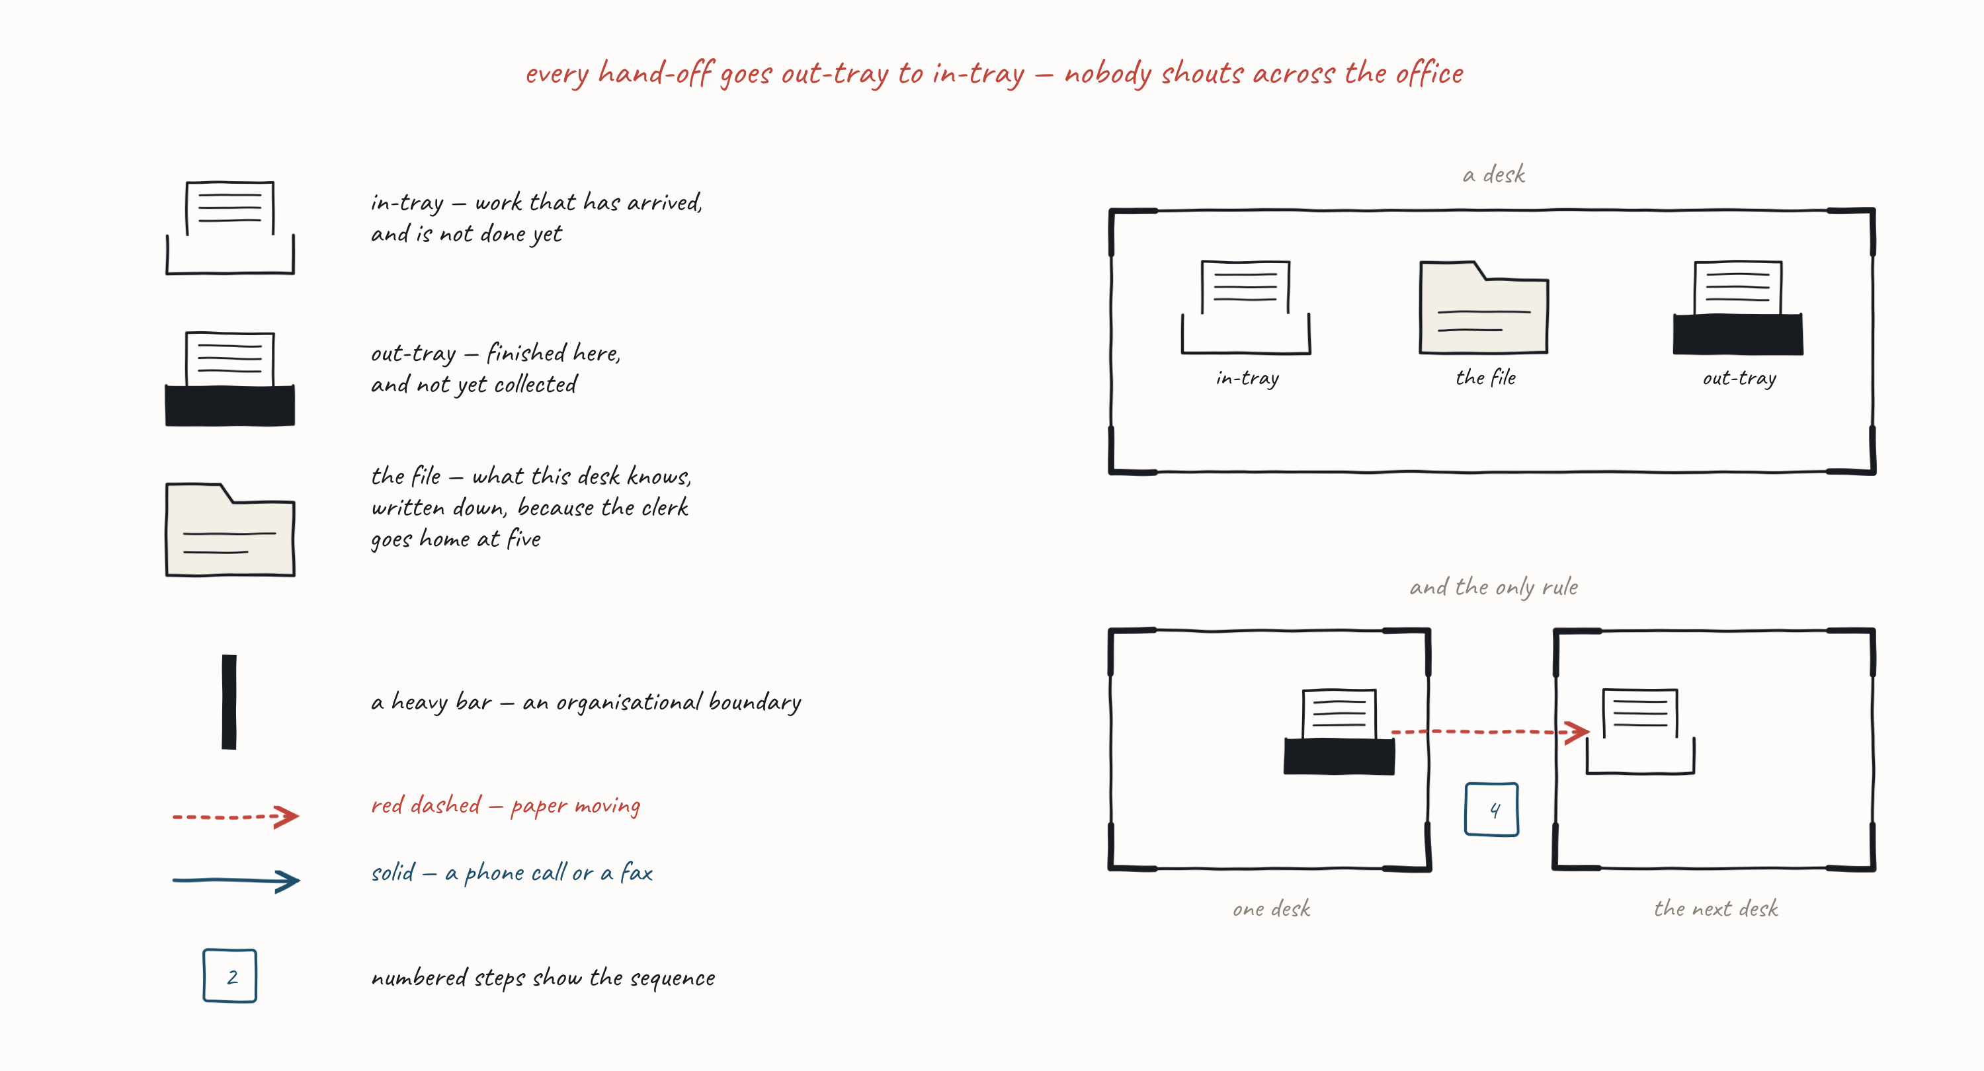
Notes:
Leave this up for the whole of round 1. It is the only thing the tables need on screen while they draw, and every table has it on paper as well. Walk the six glyphs once, then stop -- the rule at the top is the only part worth labouring: every hand-off goes out-tray to in-tray, nobody shouts across the office. Enforce it from the first minute.

Slide 5
Pick One Step and Model As A Paper Flow
Onboarding a Hotel is another Step we can model
  How do we get hotels into our catalogue?
Pre-Arrival and Arrival
  Pre-Arrival is booking a stay
  Arrival is check-in at the desk
  You can make assumptions about outputs of prior steps
    Onboarding: A catalogue of hotels
    Pre-Arrival: A booking
    Arrival: A Key
Occupancy is less obvious
  Try: making a purchase from Room Service
    Assume a Room Service Menu
Departure is how I get my bill
  Show how the flow of bills reaches my file

Slide 6
Debrief — the Worked Flows
Do not show these until the tables have drawn their own.
Notes:
STOP. Everything after this slide is an answer. The four hotel flows used to sit immediately after the task slide, which put the answers in front of the room before the work -- see-one/do-one makes that wrong, and the see-one is the takeaway, not the hotel. Reveal them one per table, in cycle order, and reveal Departure LAST: no worked flow for it exists in the delegates' world, so it is the collective piece. Ask the Departure table to walk theirs before you show ours, and if theirs is better, say so. Land the line here -- ACID transactions take place at a desk; BASE takes place across desks. It works at this moment and nowhere else, because the out-tray rule has just been enforced for forty minutes.

Slide 7
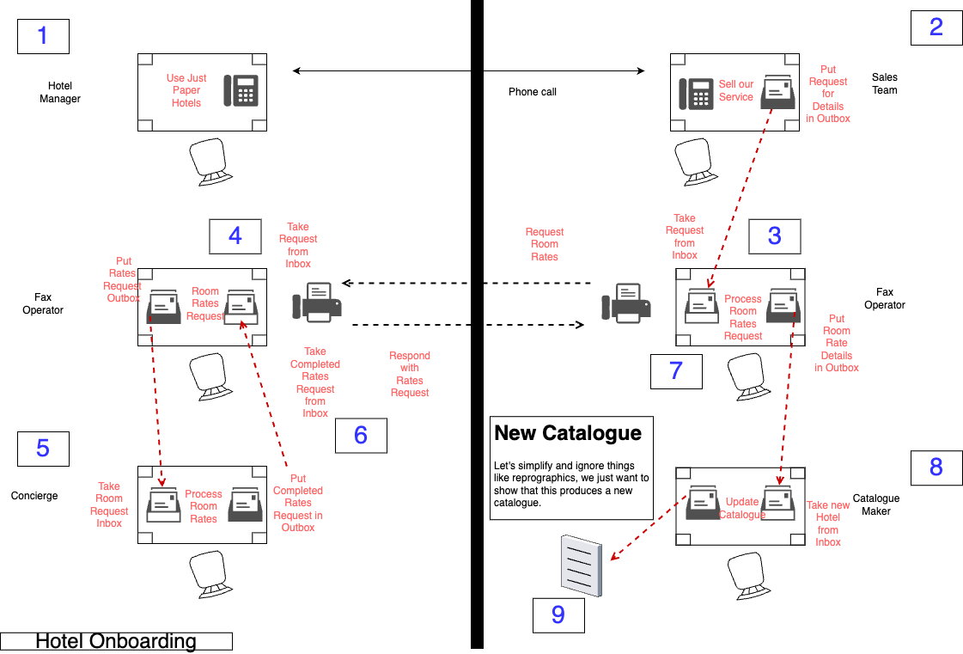
Notes:
Hotel Onboarding. Five desks and two organisations, so it has the most boundary crossings of the five -- point at the heavy bar. The Catalogue Maker is the only desk that owns the catalogue, and every later stage depends on it; that is the whole argument for why Onboarding is not a guest-cycle stage.

Slide 8
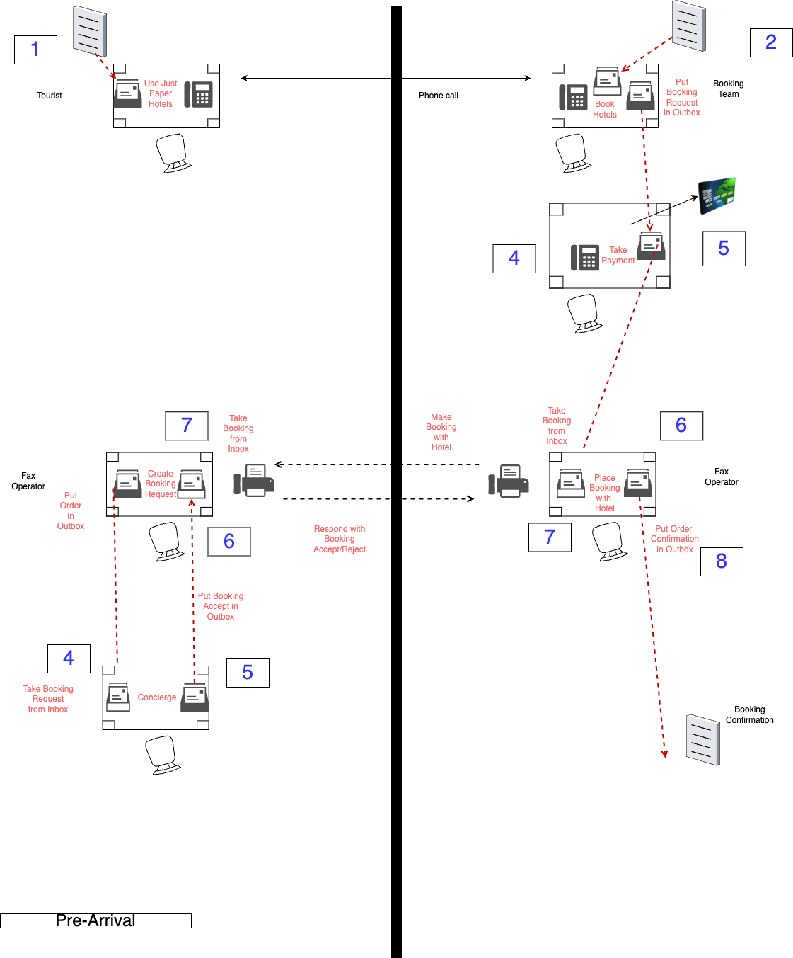
Notes:
Pre-Arrival. The one the room will recognise in Process Automation later, because its three participants become the three BPMN pools. Point at the fax operator: a desk whose entire job is moving a message between two organisations is a channel, and nobody has said that word yet.

Slide 9
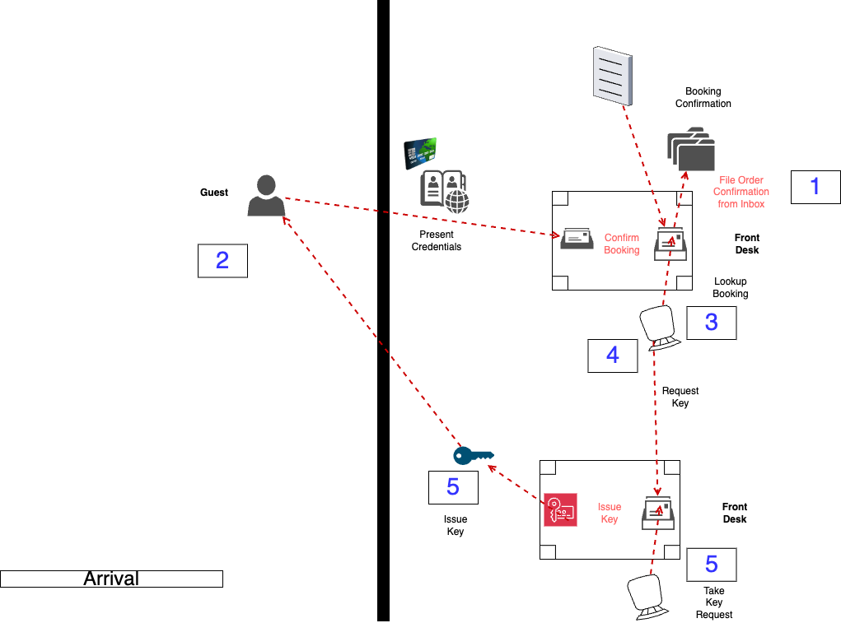
Notes:
Arrival. The shortest of the five, and the one where the file does the work -- the Front Desk files the booking confirmation, then looks it up again to issue the key. Same desk, two turns, and it cannot remember anything between them without the file.

Slide 10
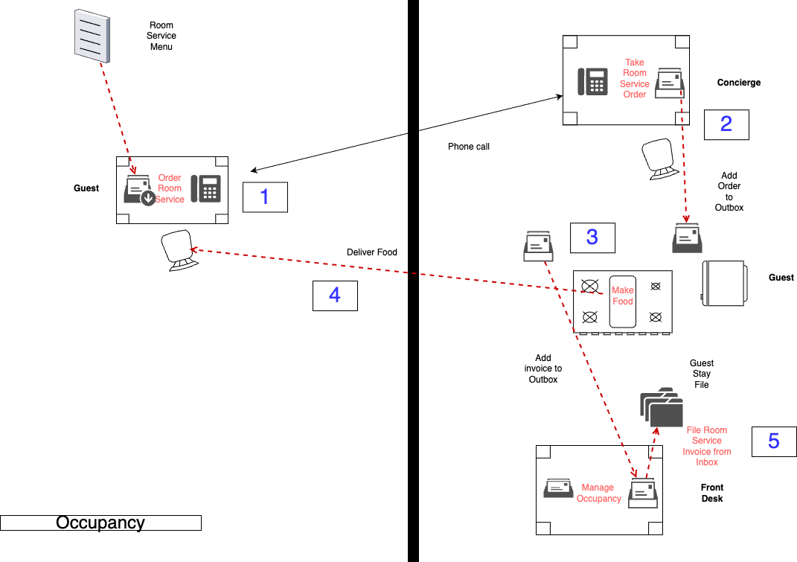
Notes:
Occupancy. Ends by filing the room-service invoice in the Guest Stay File, which is exactly where Departure picks up. Show this immediately before Departure so the room sees the join.

Slide 11
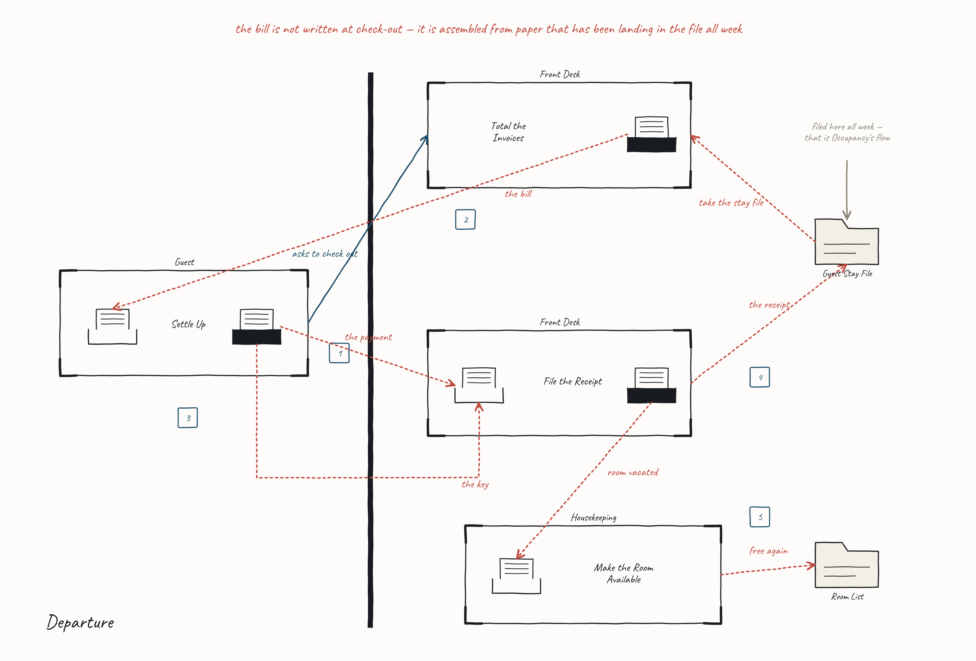
Notes:
Reveal this one last, and only after the Departure table has walked their own. Five desk-turns. Step 3 is the one to point at: the guest settles the bill and hands the key back in the same turn, so it is one number branching to two arrows -- that is how you show two things happening at once without reusing a number. The muted stub above the Guest Stay File is the answer to the question the task actually asked: the invoices have been landing in that file all week. The bill is not written at check-out; it is totalled from paper that was already there.

Slide 12
What Would This Look Like?
Take any Step from the Paper Model and think of it in FBP
  What are the Information Packets, Nodes and Ports
  Where do we have lookups?
  Where do we need to store state?
Think about what patterns of messaging we might have?
  In-Out?
  Out-Only?

